Slide 1
Lebanese University
Faculty of Information
Introduction to Programming
JAVA
Class: 1st year Data Science

Slide 2
Programming Definition
Computer programming or coding is the composition of sequences of instructions, called programs, that computers can follow to perform tasks. It involves designing and implementing algorithms, step-by-step specifications of procedures, by writing code in one or more programming languages.

Slide 3
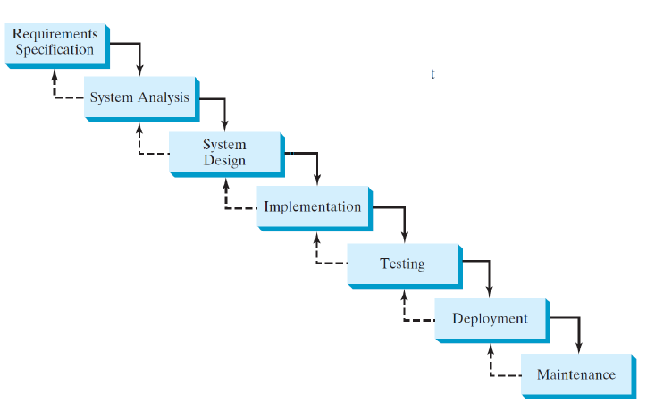
Software Development Process

Slide 4
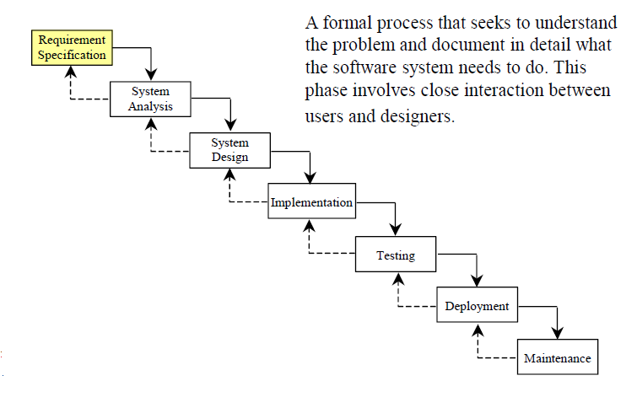
Requirement Specification

Slide 5
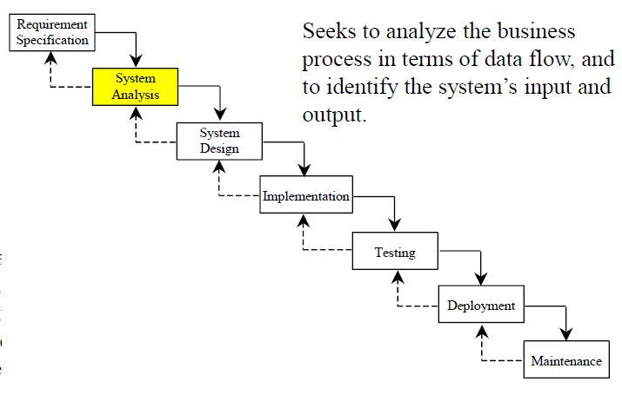
System Analysis

Slide 6
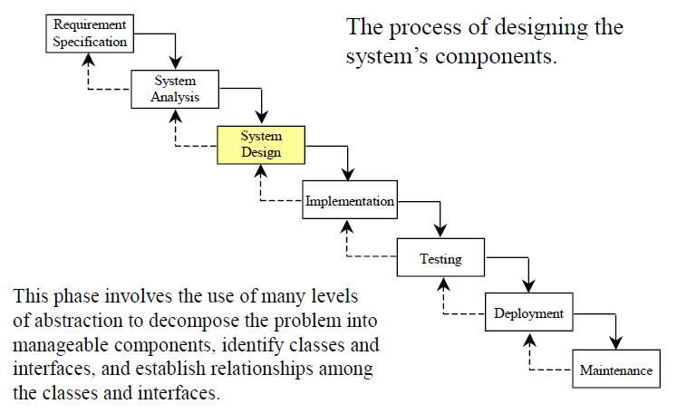
System Design

Slide 7
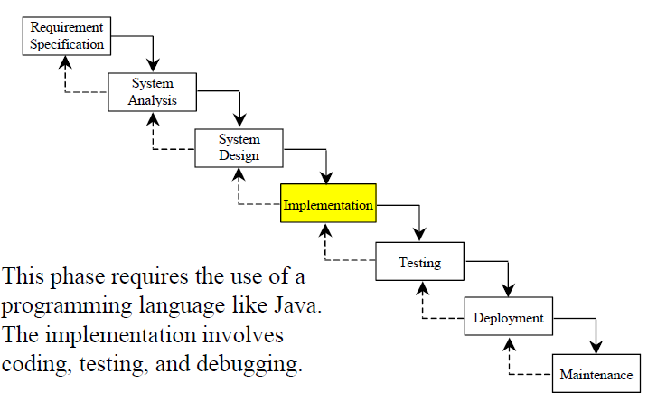
Implementation

Slide 8
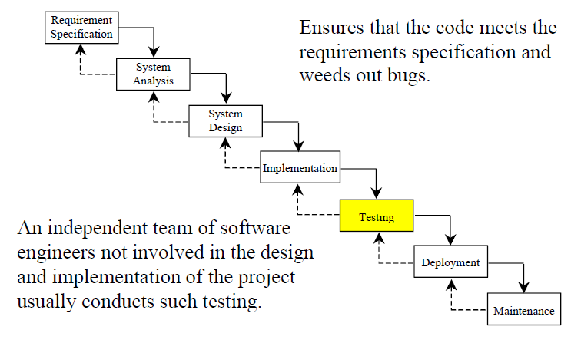
Testing

Slide 9
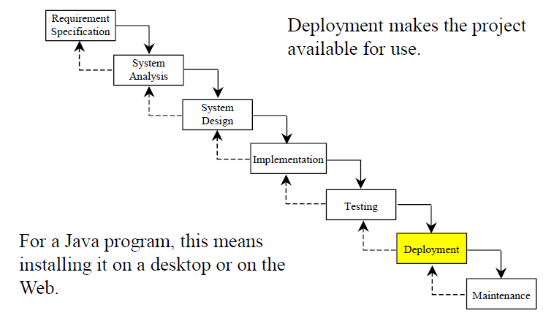
Deployment

Slide 10
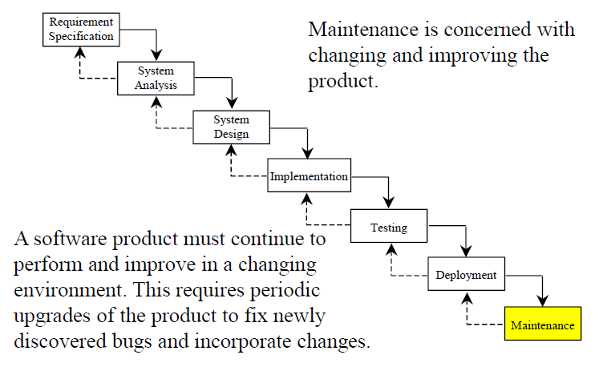
Maintenance

Slide 11
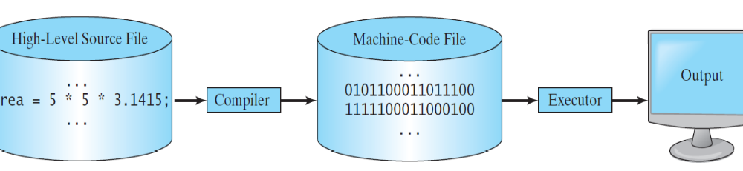
Programming to Execution Scheme

Slide 12
High level Source file
A source file is a file that contains the human-readable version of a computer program. It is written in a programming language, such as JAVA ,Python, ...

Slide 13
Compiler
A compiler is a software that translates the entire source code (high level code) into a machine-code file, and the machine-code file is then executed.
Example: JAVAC (Java Compiler)

Slide 14
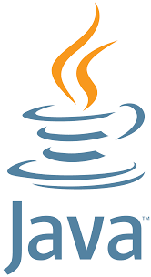
JAVA
Java is a high level ,multi-platform, object-oriented, and network-centric language that can be used as a platform in itself. It is a fast, secure, reliable programming language for coding everything from mobile apps and enterprise software to big data applications and server-side technologies.
Now owned by ORACLE, it was first introduced in May 23, 1995.

Slide 15
Why Java?
The answer is that Java enables users to develop and deploy applications on the Internet for servers, desktop computers, and small hand-held devices. The future of computing is being profoundly influenced by the Internet, and Java promises to remain a big part of that future. Java is the Internet programming language.
Java is a general purpose programming language.
Java is the Internet programming language.

Slide 16
Java, Web, and Beyond
Java can be used to develop standalone applications.
Java can be used to develop applications running from a browser.
Java can also be used to develop applications for hand-held devices.
Java can be used to develop applications for Web servers.

Slide 17
Java Is Object-Oriented
Object-oriented programming (OOP) is a popular programming approach that is replacing traditional procedural programming techniques.
One of the central issues in software development is how to reuse code. Object-oriented programming provides great flexibility, modularity, clarity, and reusability through encapsulation, inheritance, and polymorphism.

Slide 18
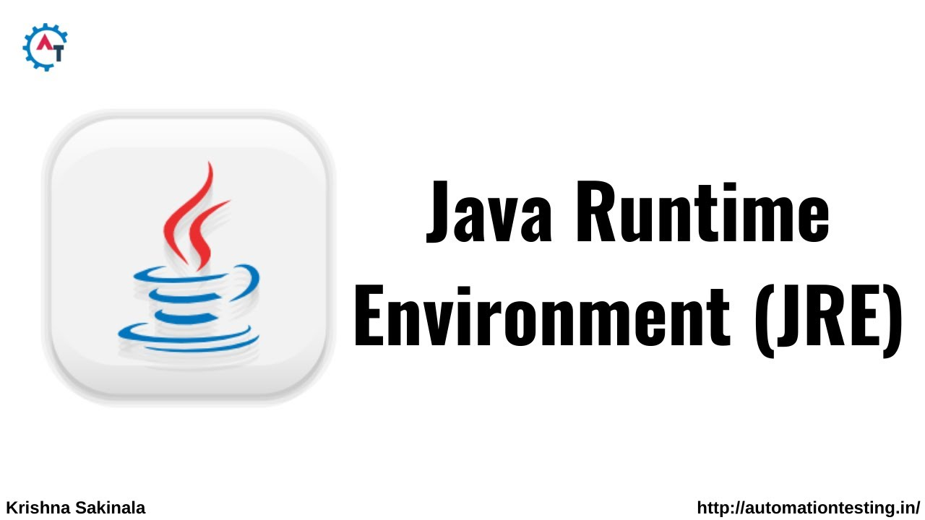
JRE(Java Runtime Environment)
The Java Runtime Environment (JRE) is software that Java programs require to run correctly. The JRE is the underlying technology that communicates between the Java program and the operating system. It acts as a translator , providing all the resources so that once you write Java software, it runs on any operating system without further modifications.

Slide 19
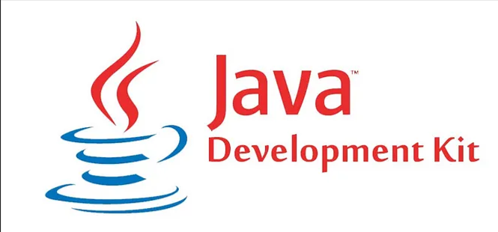
JDK(Java Development Kit)
The JDK is the development platform for building Java applications.
JDK is used to compile a Java program.
Unlike typical Java programs, the real-time Java applications require complex software toolkits and libraries available only in JDK.

Slide 20
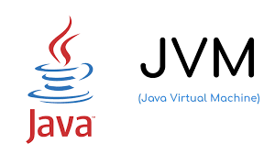
JVM(Java Virtual Machine)
When applications written in Java are compiled, they produce bytecode, which can be executed (or run) by any JVM implementation.
JVM is part of JRE.
The JVM performs the following main tasks
Loads code
Verifies code
Executes code
Provides runtime environment

Slide 21
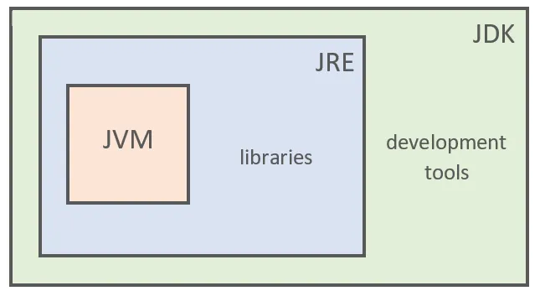
JAVA (JDK,JRE and JVM)

Slide 22
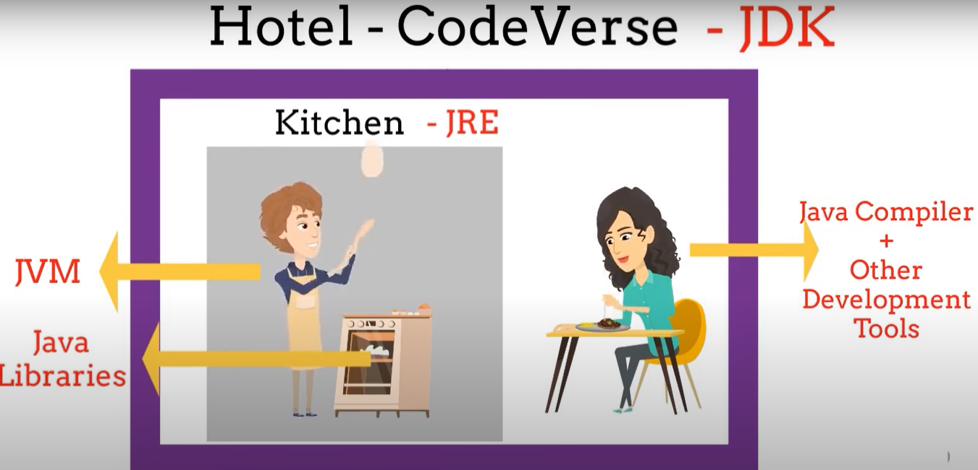
Let’s make it more simple

Slide 23
Let’s make it more simple
Let’s consider we have a hotel .
They have an excellent chef who can make food for us.
The client will ask for an order and the chef should execute it.
But the chef needs some tools like gas ,knife…etc
So we help building a kitchen for our chef that has the necessary tools.
So Our chef is the JVM that executes the orders.
JVM needs tools to execute the programs like libraries etc. The tools are the oven, the knife etc..
So JVM plus tools(libraries…) are the JRE (kitchen)
Now JRE plus Compilers and Development tools make the JDK(hotel).

Slide 24
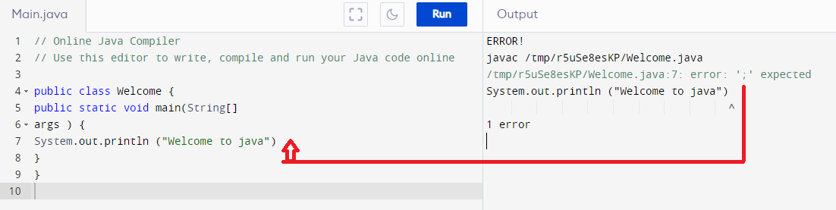
JAVA Debugger (JDB)
Java Debugger (JDB) is a tool used by Java developers to debug (find errors) Java code efficiently. It is a part of the Java Development Kit (JDK).

Slide 25
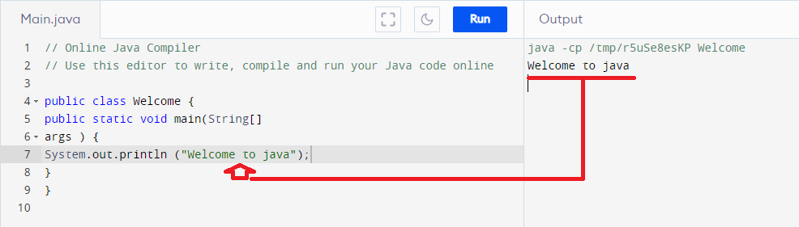
JAVA Debugger (JDB)
The debugger here found that I forgot to put a ; after the
System.out.println ("Welcome to java")
It should be:
System.out.println ("Welcome to java");

Slide 26
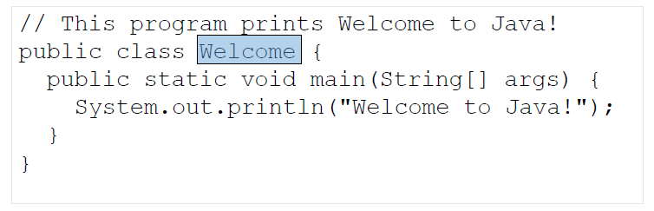
JAVA Class
Every Java program must have at least one class. Each class has a name. By convention, class names start with an uppercase letter. In this example, the class name is Welcome.

Slide 27
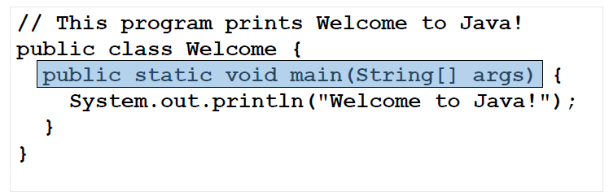
Main Method
In order to run a class, the class must contain a method named main. The program is executed from the main method.

Slide 28
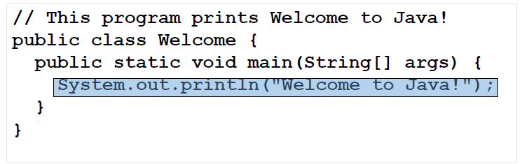
Statement
A statement represents an action or a sequence of actions. The statement System.out.println("Welcome to Java!") in the program is a statement to display the greeting "Welcome to Java!“.

Slide 29
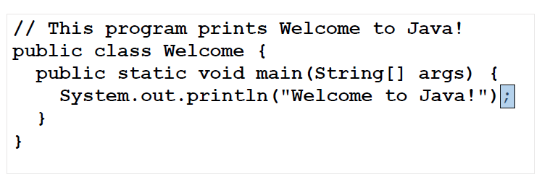
Statement Terminator ;
Every statement in Java ends with a semicolon (;)

Slide 30
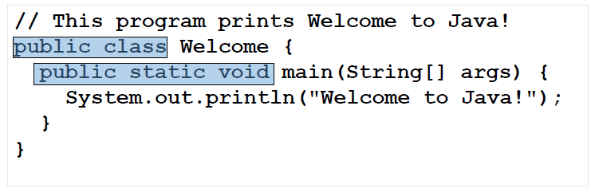
Reserved words
Reserved words or keywords are words that have a specific meaning to the compiler and cannot be used for other purposes in the program. For example, when the compiler sees the word class, it understands that the word after class is the name for the class.

Slide 31
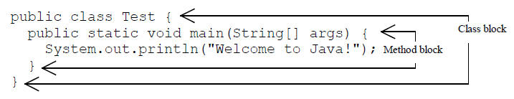
Blocks
A pair of braces {} in a program forms a block that groups components of a program.

Slide 32
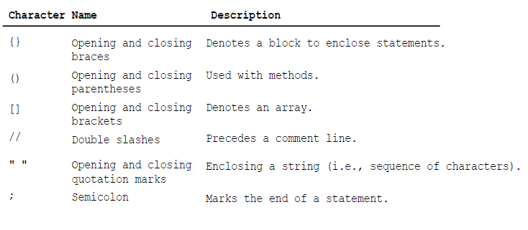
Special Symbols

Slide 33
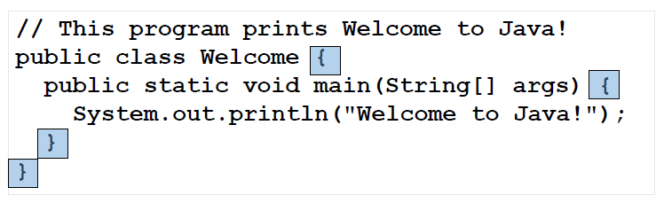
Special symbol {…}
Denotes a block to enclose statements.

Slide 34
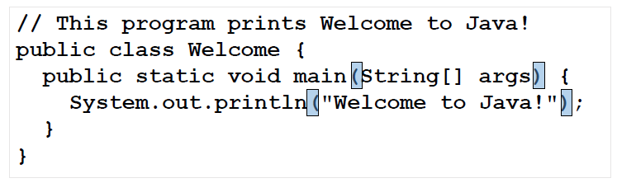
Special symbol (…)
Used with methods.

Slide 35
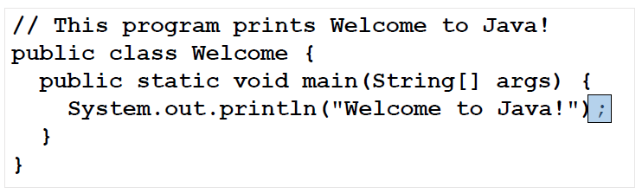
Special symbol ;
Marks the end of a statement.

Slide 36
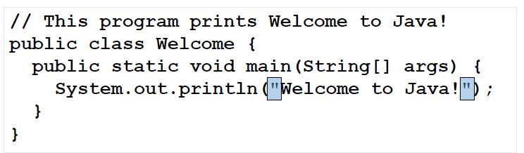
Special symbol " … "
Enclosing a string (i.e., sequence of characters).

Slide 37
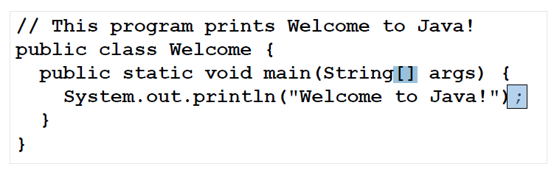
Special symbol []
[] encloses an array(table).

Slide 38
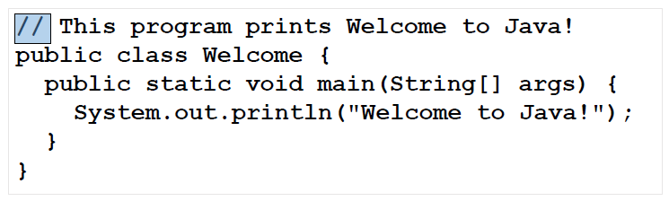
Special symbol []
Precedes a comment line. Comments help the developer highlighting lines of code. Everything after // is not part of the code it is simple comments .

